Slide 1
Software Requirement Engineering
Storyboarding
Muhammad Nasir
m.nasir@iiu.edu.pk

Slide 2
Outline
What storyboarding do?
Benefits of Storyboarding
Elements of storyboarding
Tips for storyboarding
Types of storyboarding
  Passive
  Active
  Interactive

Slide 3
Key Points
The purpose of storyboarding is to elicit early "Yes, But" reactions.
Storyboards can be passive, active, or interactive.
Storyboards identify the players, explain what happens to them, and describe how it happens.
Make the storyboard sketchy, easy to modify, and not shippable.
Storyboard early and often on each project with new or innovative content.

Slide 4
What Storyboards Do
Storyboarding represent the raw creative input used to develop the characters and the story line.
Disney's Snow White and the Seven Dwarfs, the first animated movie ever produced, used storyboards,
Storyboards still routinely used as an integral part of the creative process in movies and cartoons.

Slide 5
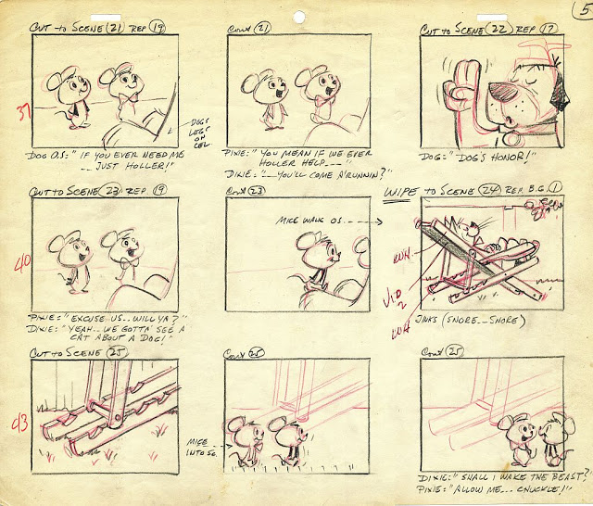
What Storyboards Do

Slide 6
What Storyboards Do
Storyboards are volatile as each user is likely to have a different opinion of how the interface should work.
Storyboards for user-based systems deal with the three essential elements:
  Who the players are (Actors)
  What happens to them (Features)
  How it happens (Events, States)

Slide 7
Elements of Storyboarding
The who element defines the players, or the users of the system.
The what element represents the behavior of the users and system as they interact with each other.

Slide 8
Elements of Storyboarding
The how element provides descriptions of how this interaction happens, showing events, states, and state transitions.

Slide 9
Elements of Storyboarding
For example, we once created a storyboard for an automated-vehicle for amusement park ride.
The who represented the guests who ride on the vehicle.
The what represented the behavior of the vehicle as it provided various features for the guests.

Slide 10
Elements of Storyboarding
The how provided further descriptions of how this interaction happens—events, state transitions—and described both the guest states (surprised, scared) and the vehicle states (accelerating, braking, unloading).

Slide 11
Tips for Storyboarding
Don't invest too much in a storyboard.
Customers will be intimidated about making changes if it looks like a real work product...
Make the storyboard easy to modify. You should be able to modify a storyboard in a few hours.

Slide 12
Tips for Storyboarding
Whenever possible, make the storyboard interactive.
The customer's experience of use will generate more feedback and will elicit more new requirements than a passive storyboard will.

Slide 13
Storyboarding: Benefits
Storyboarding:
  Is extremely inexpensive
  Is user friendly, informal, and interactive
  Provides an early review of the user interfaces of the system
  Is easy to create and easy to modify

Slide 14
Types of Storyboards
Storyboards can be categorized into three types, depending on the mode of interaction with the user.
Passive,
Active
Interactive.

Slide 15
Passive Storyboard
Tells a story to the user.
Consist of sketches, pictures, screen shots, PowerPoint presentations, or sample application outputs.
Analyst plays the role of the system
Walks the user through the storyboard, with a "When you do this, this happens" explanation.

Slide 16
Active Storyboards
Consists of animated or even a homemade movie.
Active storyboards provide an automated description of the way the system behaves in a typical usage or operational scenario.

Slide 17
Interactive Storyboard
let the user experience the system in as realistic a manner as practical.
Interactive storyboards can be simulations or mock-ups or can be advanced to the point of throwaway Prototype.

Slide 18
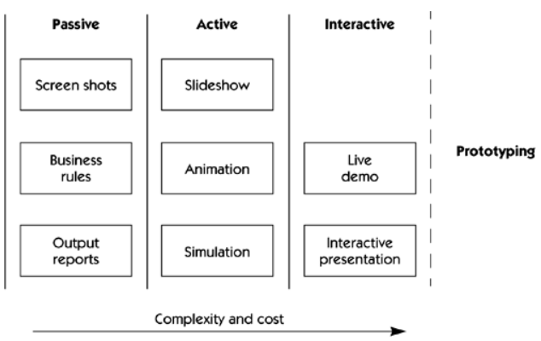
Storyboarding Continuum

Slide 19
The End
Thanks for listening
Questions would be appreciated.

